Slide 1
Building a Better Battery with Data Driven Techniques
Under the Supervision of
Dr. B. Pattabhi Ramaiah
Submitted by
Prateek Gandhi
MTech, Mechanical Systems Design
IIT Bhubaneswar
25-11-2021

Slide 2
Objective
To explore the unknown part of material science where we are combining, what we know from the conventional approaches, with these new ideas from big data and machine learning to accelerate the current work of search for materials for solid electrolytes in the lithium-ion batteries.
Understand how machine learning works.
Solid-State Batteries.
25-11-2021

Slide 3
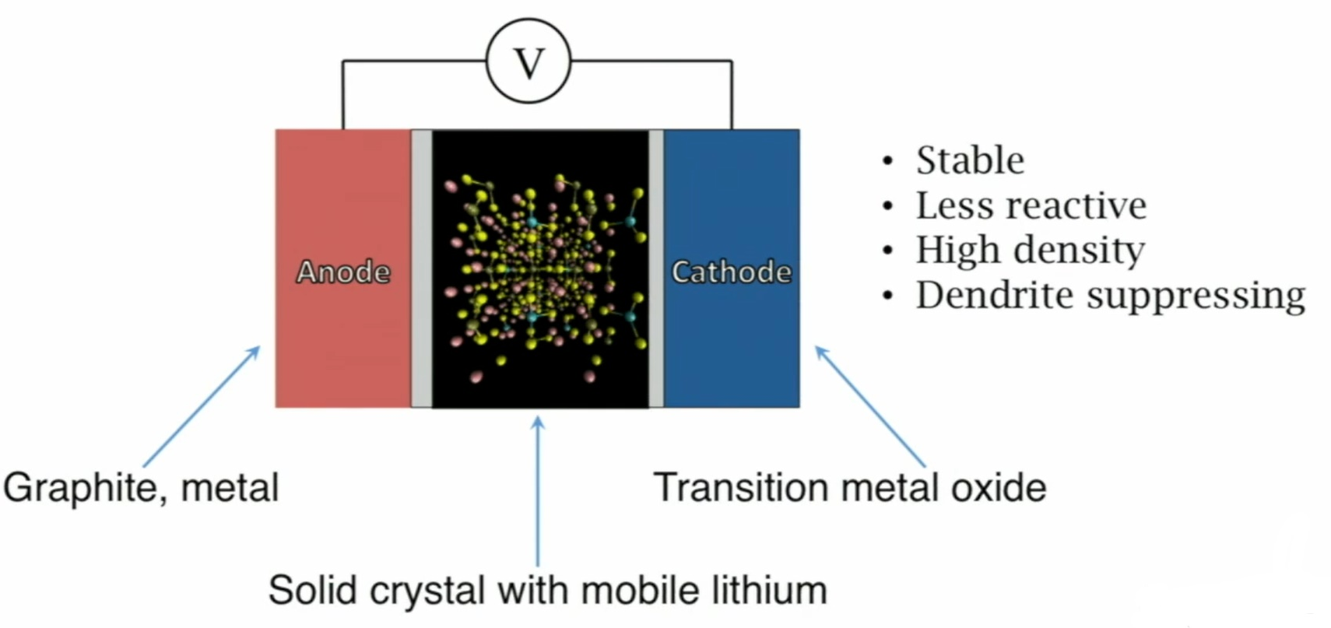
A major problem worth solving: Liquid Electrolytes
Figure: A schematic of a solid electrolyte battery^{[5]}
[5] Sendek, Austin D., Qian Yang, Ekin D. Cubuk, Karel-Alexander N. Duerloo, Yi Cui, and Evan J. Reed. "Holistic computational structure screening of more than 12000 candidates for solid lithium-ion conductor materials." Energy & Environmental Science 10, no. 1 (2017): 306-320.
25-11-2021

Slide 4
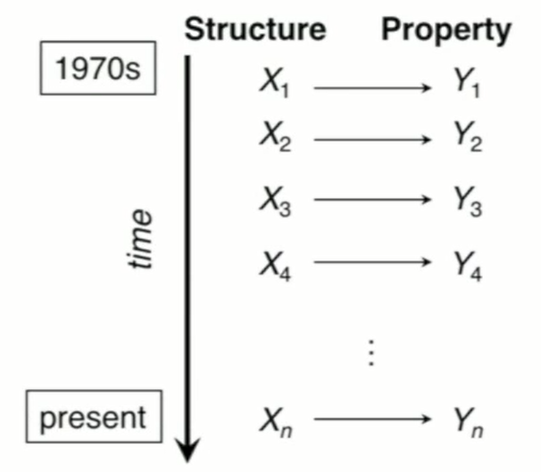
Existing discovery efforts are driven by trial and error
This can be formulated as a supervised learning problem:
f(X) = Y
f(structure) = property
Can we learn effectively from the data we have already generated?
Machine Learning may improve success rate beyond trial-and-error!
Figure: XY pairs where X is a material that was picked by a random guess and Y is the property which was being measured [5]
[5] Sendek, Austin D., Qian Yang, Ekin D. Cubuk, Karel-Alexander N. Duerloo, Yi Cui, and Evan J. Reed. "Holistic computational structure screening of more than 12000 candidates for solid lithium-ion conductor materials." Energy & Environmental Science 10, no. 1 (2017): 306-320.
25-11-2021

Slide 5
40 experimental measurements of conductivity
No single feature has strong correlation with ionic conductivity across all the 40 materials.
Hence, they adopted a binary classification strategy with a 10^-4 S/cm boundary, motivated by engineering requirements .
Training set includes 11 “good” conductors, 29 “bad” conductors. [5]
[5] Sendek, Austin D., Qian Yang, Ekin D. Cubuk, Karel-Alexander N. Duerloo, Yi Cui, and Evan J. Reed. "Holistic computational structure screening of more than 12000 candidates for solid lithium-ion conductor materials." Energy & Environmental Science 10, no. 1 (2017): 306-320.
25-11-2021

Slide 6
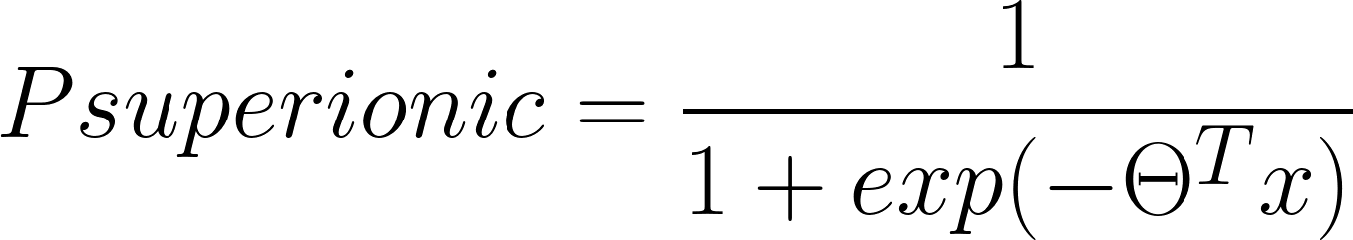
Prediction of Superionic behaviour
20 candidate features
40 experimental data points
Find feature set that best reproduces the data under cross-validation
[5] Sendek, Austin D., Qian Yang, Ekin D. Cubuk, Karel-Alexander N. Duerloo, Yi Cui, and Evan J. Reed. "Holistic computational structure screening of more than 12000 candidates for solid lithium-ion conductor materials." Energy & Environmental Science 10, no. 1 (2017): 306-320.
25-11-2021

Slide 7
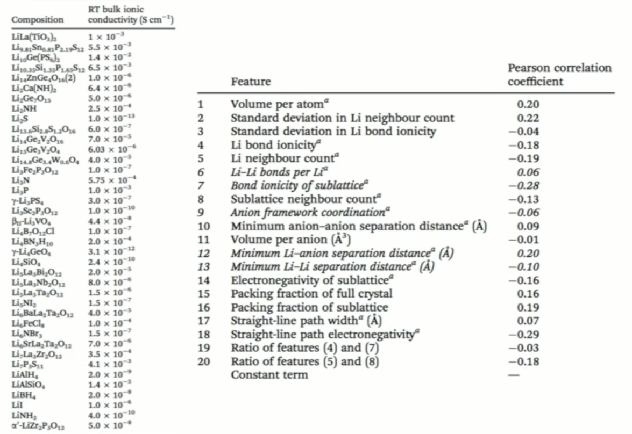
Figure: 40 experimental measurements of conductivity and 20 features for predicting ionic conductivity. ^{[5]}
[5] Sendek, Austin D., Qian Yang, Ekin D. Cubuk, Karel-Alexander N. Duerloo, Yi Cui, and Evan J. Reed. "Holistic computational structure screening of more than 12000 candidates for solid lithium-ion conductor materials." Energy & Environmental Science 10, no. 1 (2017): 306-320.
25-11-2021

Slide 8
Logistic Regression
It’s a classification algorithm, that is used where the response variable is categorical. The idea of Logistic Regression is to find a relationship between features and probability of particular outcome.
Maximum Likelihood Estimation is used to estimate regression coefficients.
There can be infinite sets of regression coefficients. The maximum likelihood estimate is that set of regression coefficients for which the probability of getting the data we have observed is maximum. [8]
[8] https://medium.com/data-science-group-iitr/logistic-regression-simplified-9b4efe801389
25-11-2021

Slide 9
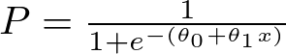
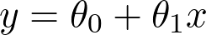
Underlying Mathematics
[16] https://nptel.ac.in/courses/106/106/106106139/
25-11-2021

Slide 10
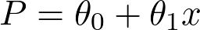
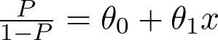
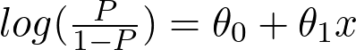
Underlying Mathematics
[16] https://nptel.ac.in/courses/106/106/106106139/
25-11-2021

Slide 11
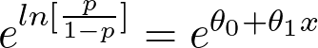
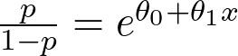
Underlying Mathematics
[16] https://nptel.ac.in/courses/106/106/106106139/
25-11-2021

Slide 12
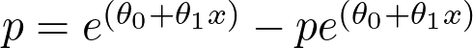
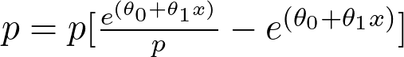
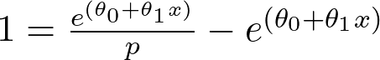
Underlying Mathematics
[16] https://nptel.ac.in/courses/106/106/106106139/
25-11-2021

Slide 13
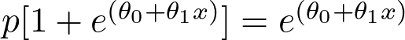
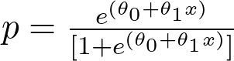
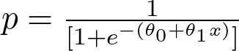
Underlying Mathematics
[16] https://nptel.ac.in/courses/106/106/106106139/
25-11-2021

Slide 14
Logistic Regression
Assuming a logistic form as shown in Eqn. 1, we search for maximally predictive set of features:
(1)
Where 𝚹s are the regression coefficients.
[5] Sendek, Austin D., Qian Yang, Ekin D. Cubuk, Karel-Alexander N. Duerloo, Yi Cui, and Evan J. Reed. "Holistic computational structure screening of more than 12000 candidates for solid lithium-ion conductor materials." Energy & Environmental Science 10, no. 1 (2017): 306-320.
25-11-2021

Slide 15
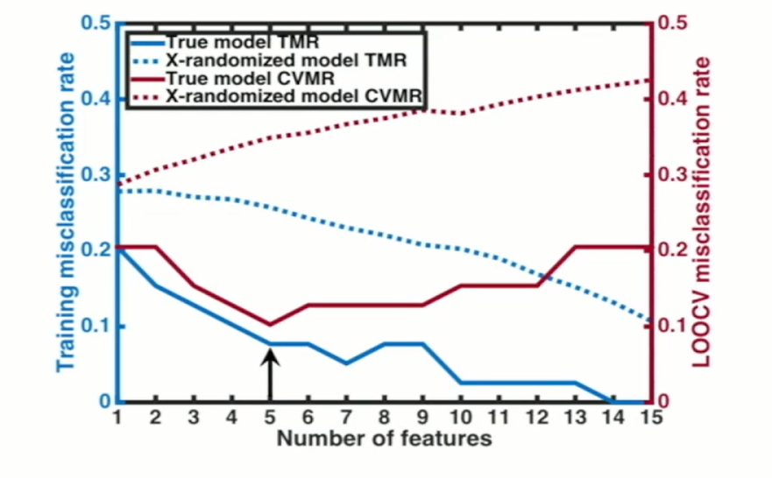
Determination of Optimal Features
They used LR to build all possible models and then calculated the training misclassification rate (TMR) and the cross-validated misclassification rate (CVMR).
As shown, the 5-feature model had minimal CVMR, proving that the model had statistical significance.
[5] Sendek, Austin D., Qian Yang, Ekin D. Cubuk, Karel-Alexander N. Duerloo, Yi Cui, and Evan J. Reed. "Holistic computational structure screening of more than 12000 candidates for solid lithium-ion conductor materials." Energy & Environmental Science 10, no. 1 (2017): 306-320.
25-11-2021

Slide 16
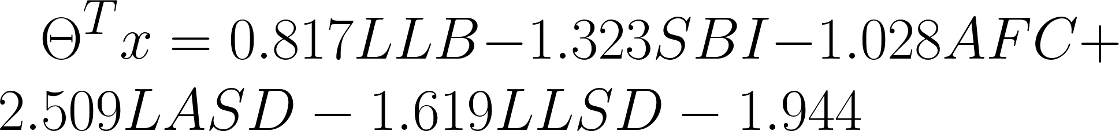
ML finds the best Li conduction model for this data set
(1)
(2)
Where LLB is Lithium-lithium bond number, SBI is Sublattice bond ionicity, AFC is Anion framework coordination, LASD is Li-anion separation distance and LLSD is Li-Li separation distance.
>1 week with DFT <1s with ML
[5] Sendek, Austin D., Qian Yang, Ekin D. Cubuk, Karel-Alexander N. Duerloo, Yi Cui, and Evan J. Reed. "Holistic computational structure screening of more than 12000 candidates for solid lithium-ion conductor materials." Energy & Environmental Science 10, no. 1 (2017): 306-320.
25-11-2021

Slide 17
Holistic structure screening of > 12,000 candidates
Screening is done on features like:
High stability against oxidation
High stability against reduction
Low electronic conductivity
High phase stability
Low cost
High earth abundance
All Li-containing materials: >12,000
All requirements except ionic conductivity: 317
All requirements: 21^{[5]}
[5] Sendek, Austin D., Qian Yang, Ekin D. Cubuk, Karel-Alexander N. Duerloo, Yi Cui, and Evan J. Reed. "Holistic computational structure screening of more than 12000 candidates for solid lithium-ion conductor materials." Energy & Environmental Science 10, no. 1 (2017): 306-320.
25-11-2021

Slide 18
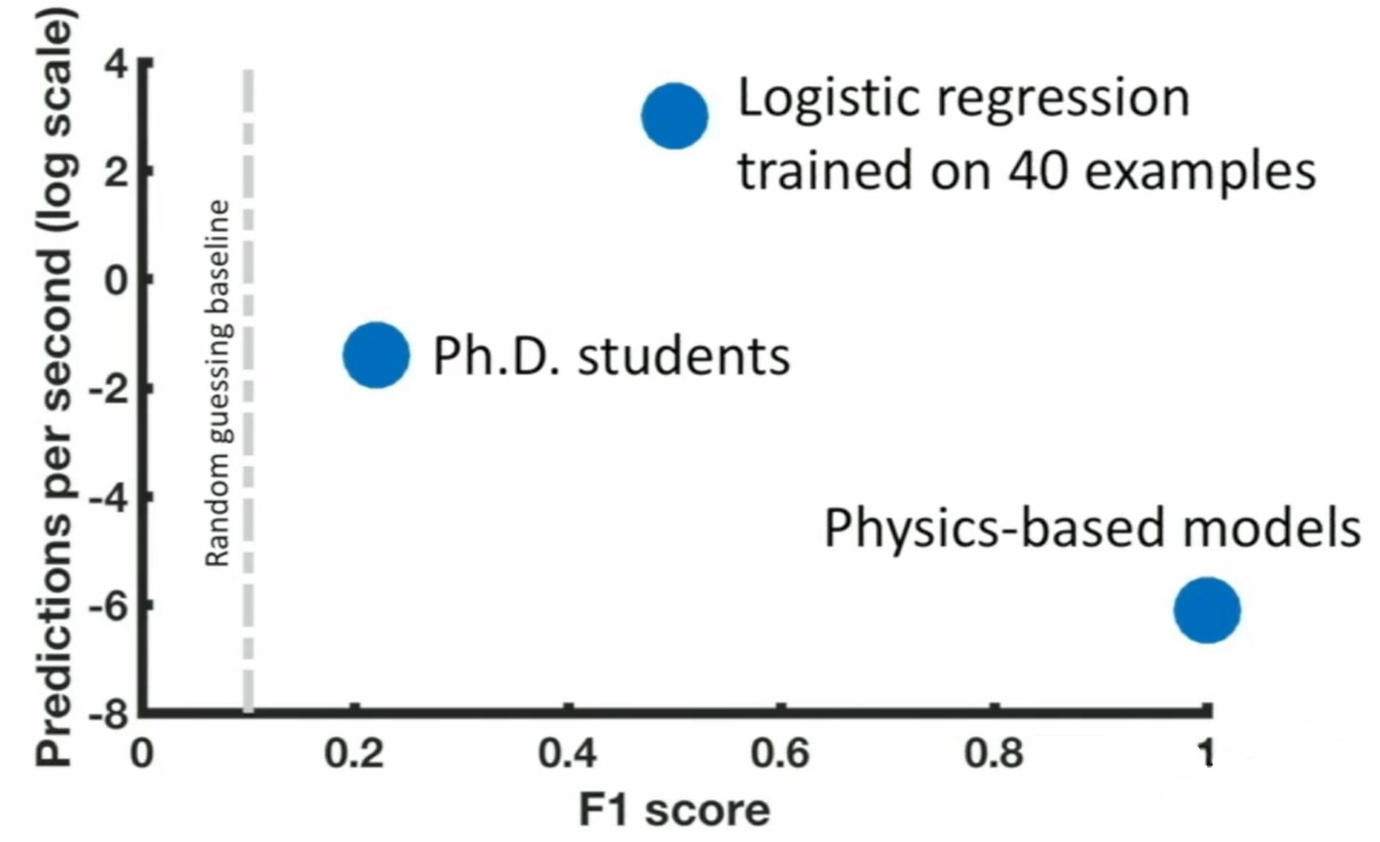
Algorithm outperforms humans in accuracy and speed
Figure: Performance of PhD students, ML Model and Physics-based models on predicting good candidate material^{[6]}
[6] Sendek, Austin D., Ekin D. Cubuk, Evan R. Antoniuk, Gowoon Cheon, Yi Cui, and Evan J. Reed. "Machine learning-assisted discovery of many new solid li-ion conducting materials." arXiv preprint arXiv:1808.02470 (2018).
25-11-2021

Slide 19
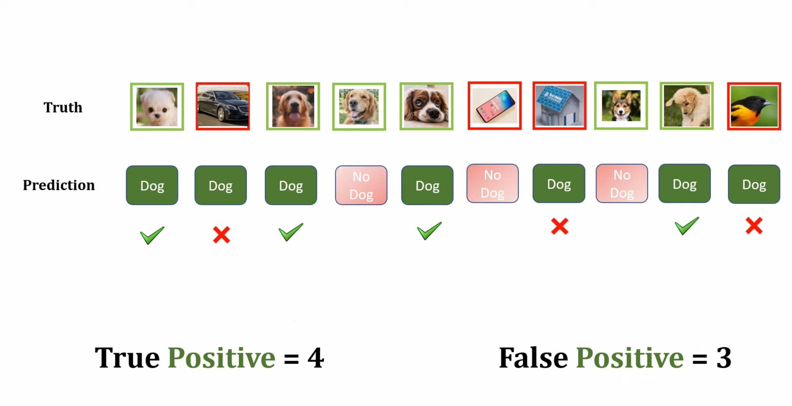
F1 Score
[19] https://medium.com/analytics-vidhya/confusion-matrix-accuracy-precision-recall-f1-score-ade299cf63cd
25-11-2021

Slide 20
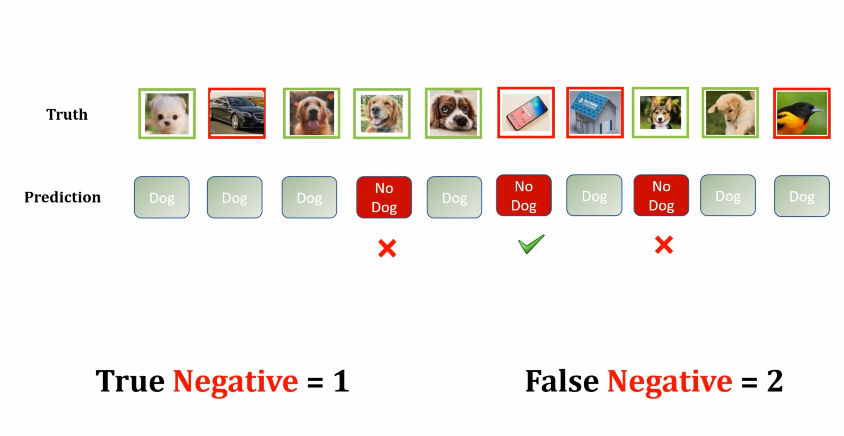
F1 Score
[19] https://medium.com/analytics-vidhya/confusion-matrix-accuracy-precision-recall-f1-score-ade299cf63cd
25-11-2021

Slide 21
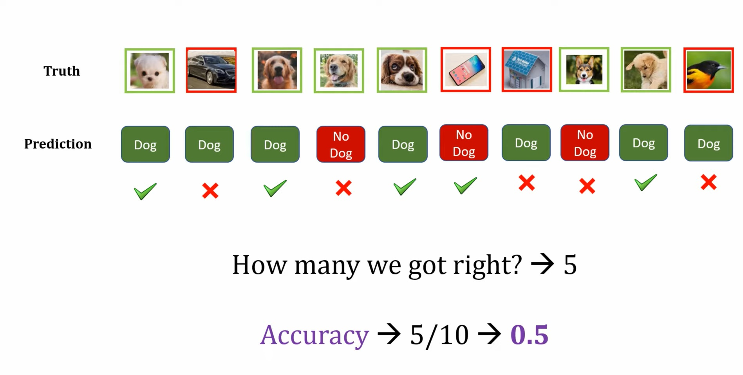
F1 Score
[19] https://medium.com/analytics-vidhya/confusion-matrix-accuracy-precision-recall-f1-score-ade299cf63cd
25-11-2021

Slide 22
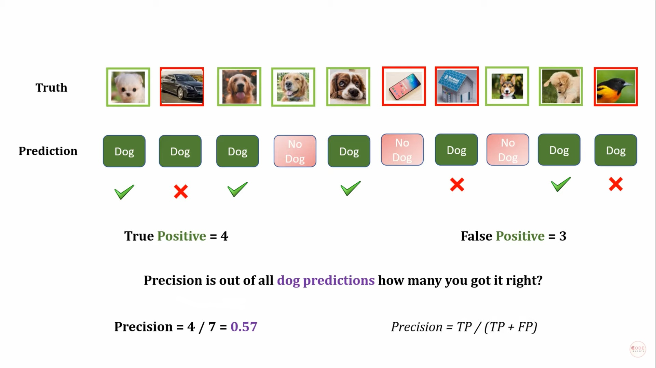
F1 Score
[19] https://medium.com/analytics-vidhya/confusion-matrix-accuracy-precision-recall-f1-score-ade299cf63cd
25-11-2021

Slide 23
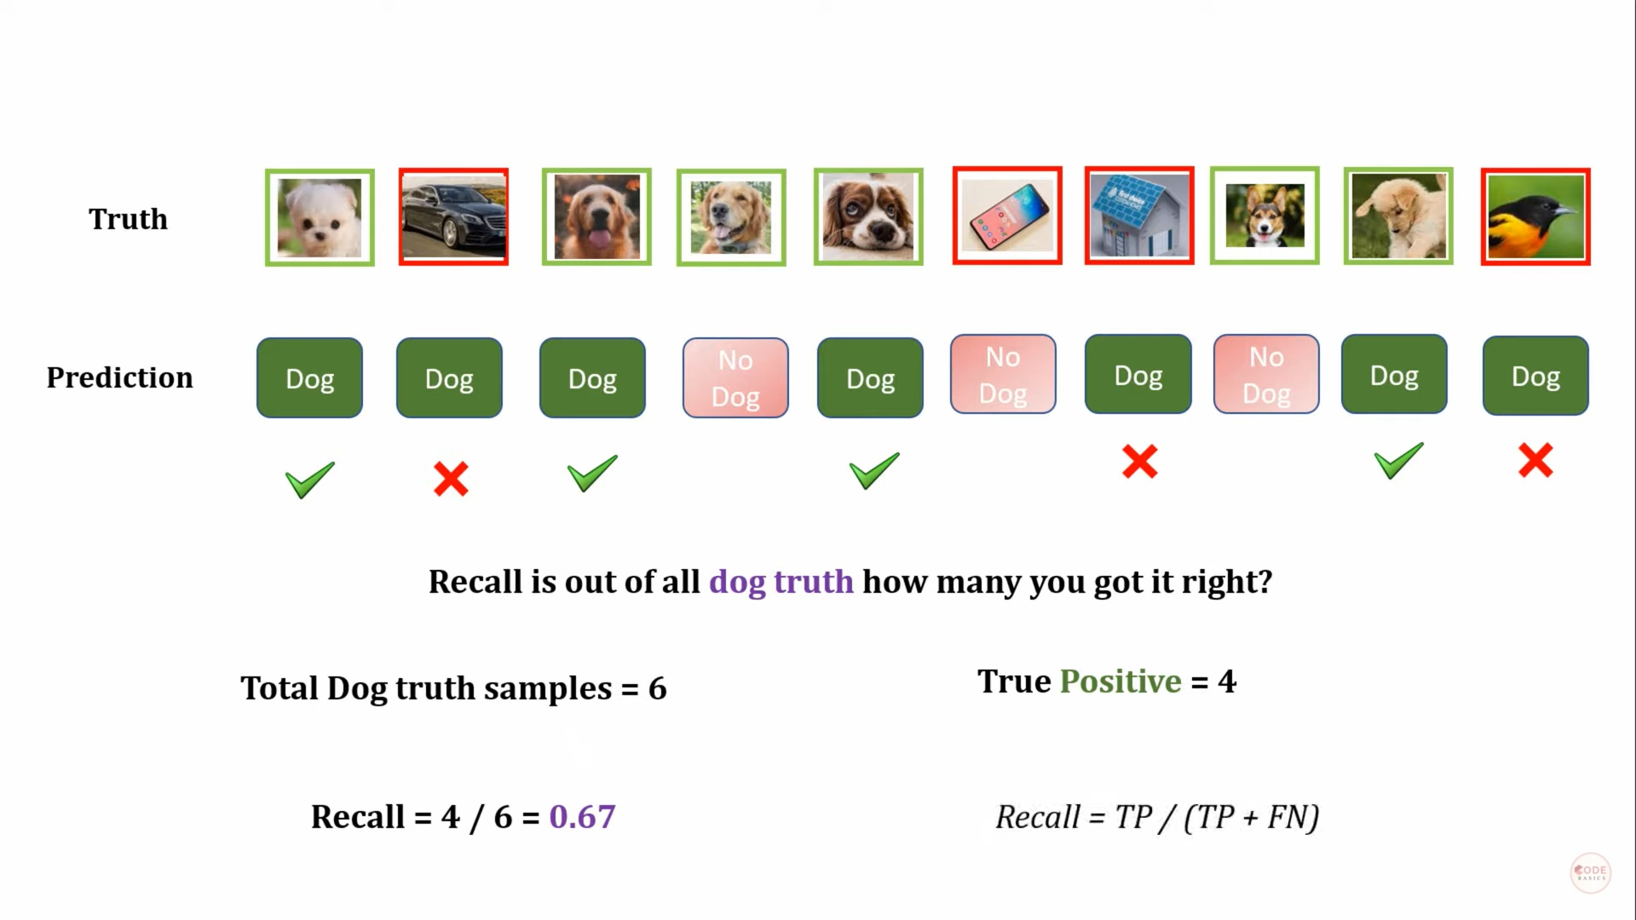
F1 Score
[19] https://medium.com/analytics-vidhya/confusion-matrix-accuracy-precision-recall-f1-score-ade299cf63cd
25-11-2021

Slide 24
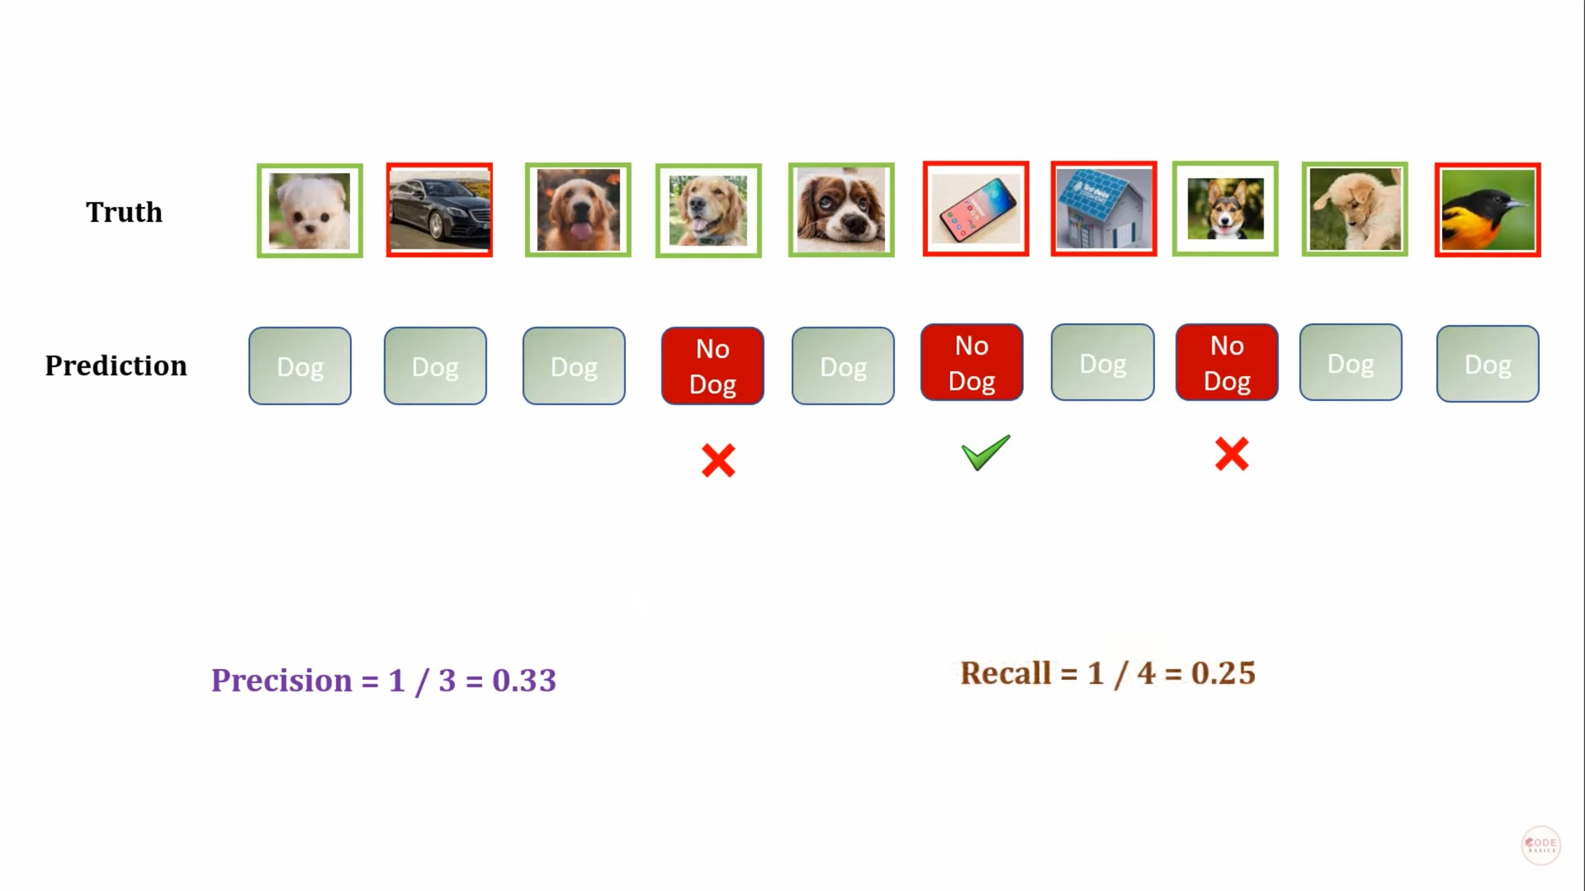
F1 Score
[19] https://medium.com/analytics-vidhya/confusion-matrix-accuracy-precision-recall-f1-score-ade299cf63cd
25-11-2021

Slide 25
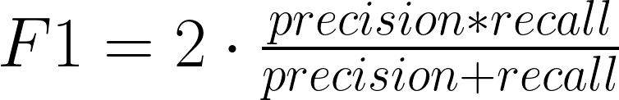
F1 Score
https://colab.research.google.com/drive/1p-_OBcZXUgle0RUqAAafE_HQ2zdS8QPo?usp=sharing
[19] https://medium.com/analytics-vidhya/confusion-matrix-accuracy-precision-recall-f1-score-ade299cf63cd
25-11-2021

Slide 26
Simultaneous optimization of Conductivity and Stability
Fluorides
Li-(X)-Y
Electrochemical Stability
Oxides
Everything else?
Sulphides
Ionic Conductivity
[14] Wang, Shuo, Qiang Bai, Adelaide M. Nolan, Yunsheng Liu, Sheng Gong, Qiang Sun, and Yifei Mo. "Lithium Chlorides and Bromides as Promising Solid‐State Chemistries for Fast Ion Conductors with Good Electrochemical Stability." Angewandte Chemie International Edition 58, no. 24 (2019): 8039-8043.
25-11-2021

Slide 27
Simultaneous optimization of Conductivity and Stability
Fluorides
We want these outliers
Li-(X)-Y
Electrochemical Stability
Oxides
Everything else?
Sulphides
Ionic Conductivity
[14] Wang, Shuo, Qiang Bai, Adelaide M. Nolan, Yunsheng Liu, Sheng Gong, Qiang Sun, and Yifei Mo. "Lithium Chlorides and Bromides as Promising Solid‐State Chemistries for Fast Ion Conductors with Good Electrochemical Stability." Angewandte Chemie International Edition 58, no. 24 (2019): 8039-8043.
25-11-2021

Slide 28
Simultaneous optimization of Conductivity and Stability
“Are we more likely to find a high performance outlier from the sulphides or the oxides?”
We want to make these trends quantitative.
This is very difficult to do with first principles.
This model + DFT stability methods allow us to answer these questions with data.
The model is “the best we can do with the data we have”
[14] Wang, Shuo, Qiang Bai, Adelaide M. Nolan, Yunsheng Liu, Sheng Gong, Qiang Sun, and Yifei Mo. "Lithium Chlorides and Bromides as Promising Solid‐State Chemistries for Fast Ion Conductors with Good Electrochemical Stability." Angewandte Chemie International Edition 58, no. 24 (2019): 8039-8043.
25-11-2021

Slide 29
Model allows us to aggregate and analyze material performance data
25-11-2021

Slide 30
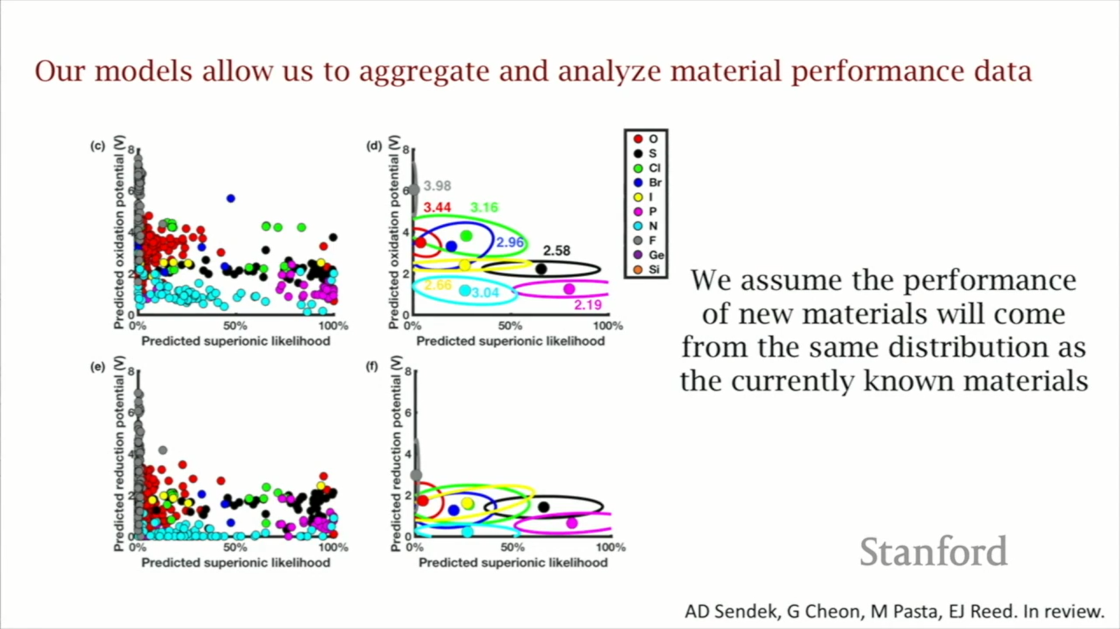
We assume the performance of new materials will come from the same distribution as the currently known materials.[14]
[14] Wang, Shuo, Qiang Bai, Adelaide M. Nolan, Yunsheng Liu, Sheng Gong, Qiang Sun, and Yifei Mo. "Lithium Chlorides and Bromides as Promising Solid‐State Chemistries for Fast Ion Conductors with Good Electrochemical Stability." Angewandte Chemie International Edition 58, no. 24 (2019): 8039-8043.
25-11-2021

Slide 31
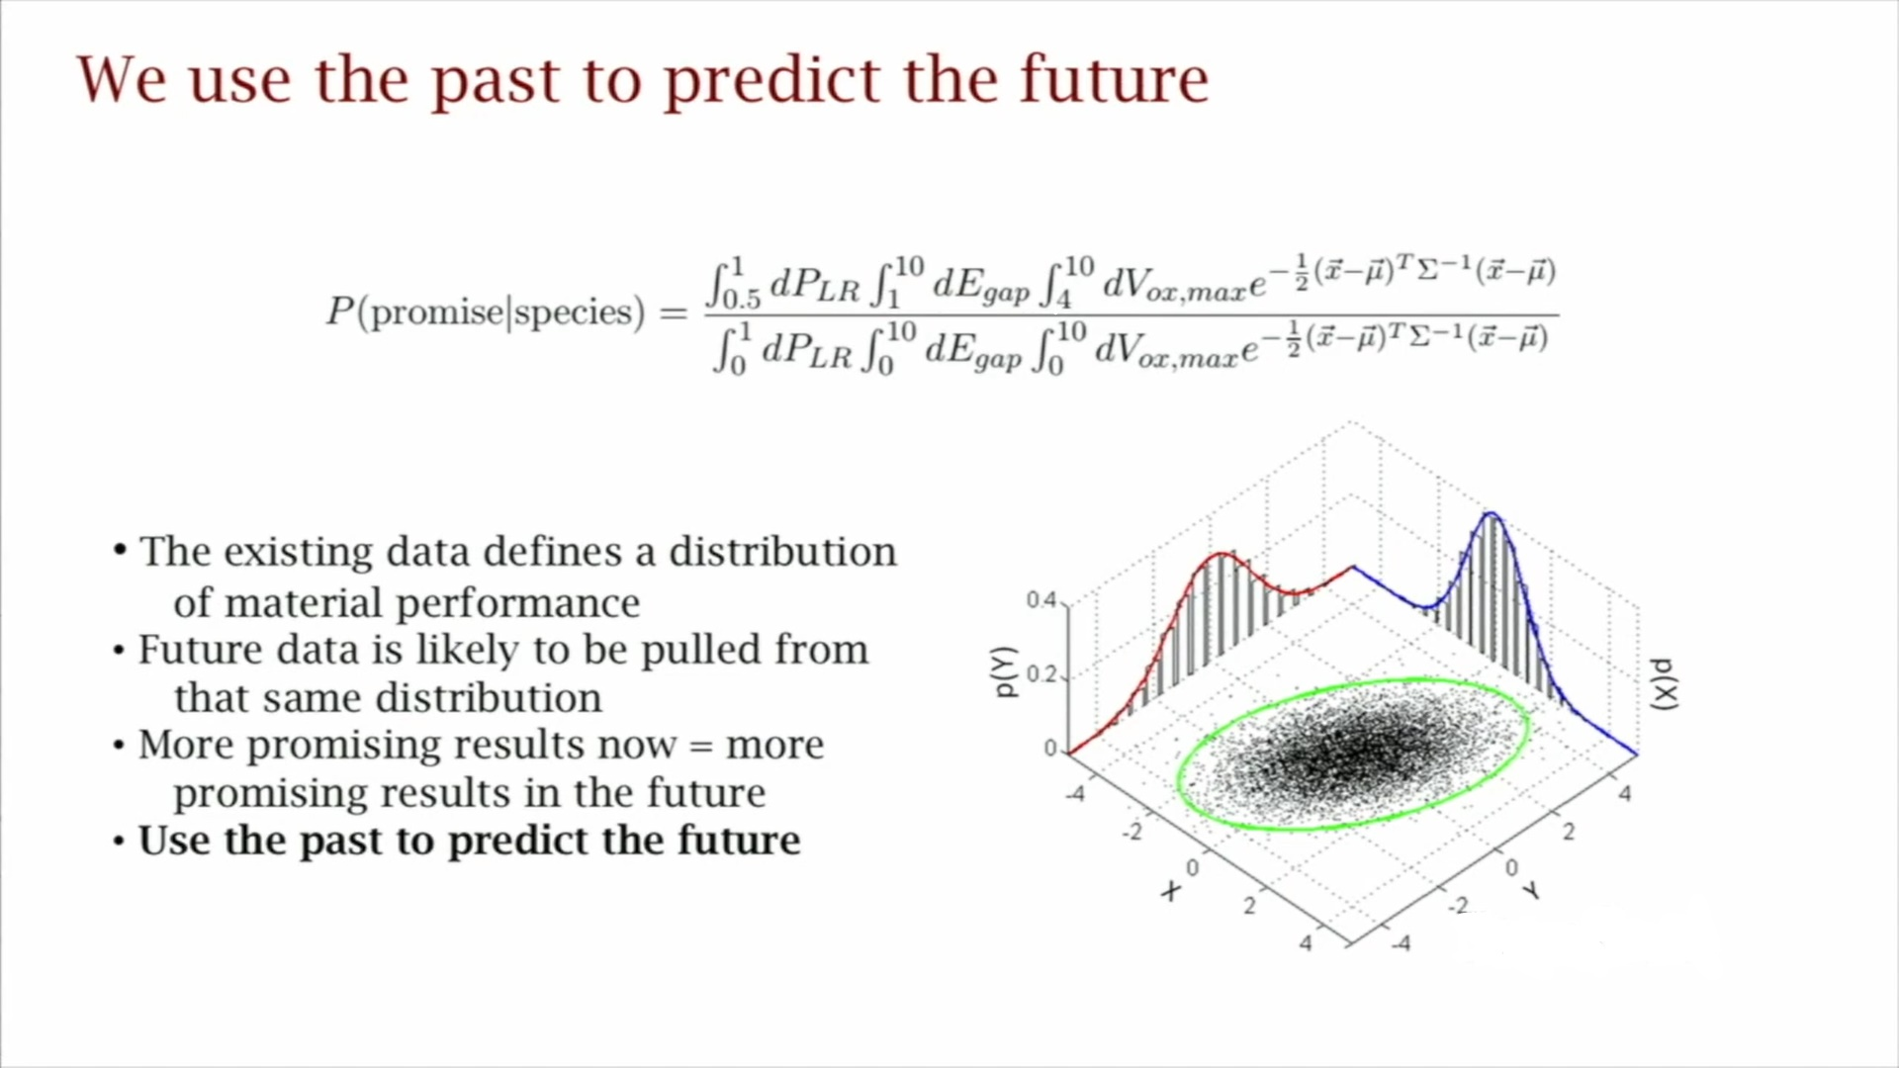
We use the past to predict the future
The existing data defines a distribution of material performance.
Future data is likely to be pulled from that same distribution.
More promising results now = more promising results in the future.
Use the past to predict the future.
[6] Sendek, Austin D., Ekin D. Cubuk, Evan R. Antoniuk, Gowoon Cheon, Yi Cui, and Evan J. Reed. "Machine learning-assisted discovery of many new solid li-ion conducting materials." arXiv preprint arXiv:1808.02470 (2018).
25-11-2021

Slide 32
Conclusions for discovery likelihoods for all families
Fast conducting and >4V stability:
Oxides are very unlikely to produce high performance outliers.
Sulfides are more likely than oxides.
The data is limited for the halides, but they look particularly promising, especially the chlorides.
Certain families are better against reduction and some are better against oxidation.
[14] Wang, Shuo, Qiang Bai, Adelaide M. Nolan, Yunsheng Liu, Sheng Gong, Qiang Sun, and Yifei Mo. "Lithium Chlorides and Bromides as Promising Solid‐State Chemistries for Fast Ion Conductors with Good Electrochemical Stability." Angewandte Chemie International Edition 58, no. 24 (2019): 8039-8043.
25-11-2021

Slide 33
Simultaneous optimization of stability and conductivity
Fluorides
“WONDER MATERIAL”
Stable against Li metal.
Stable against high V cathodes.
Fast ion conductor.
Electrochemical Stability
Oxides
Everything else?
Sulphides
Ionic Conductivity
[6] Sendek, Austin D., Ekin D. Cubuk, Evan R. Antoniuk, Gowoon Cheon, Yi Cui, and Evan J. Reed. "Machine learning-assisted discovery of many new solid li-ion conducting materials." arXiv preprint arXiv:1808.02470 (2018).
25-11-2021

Slide 34
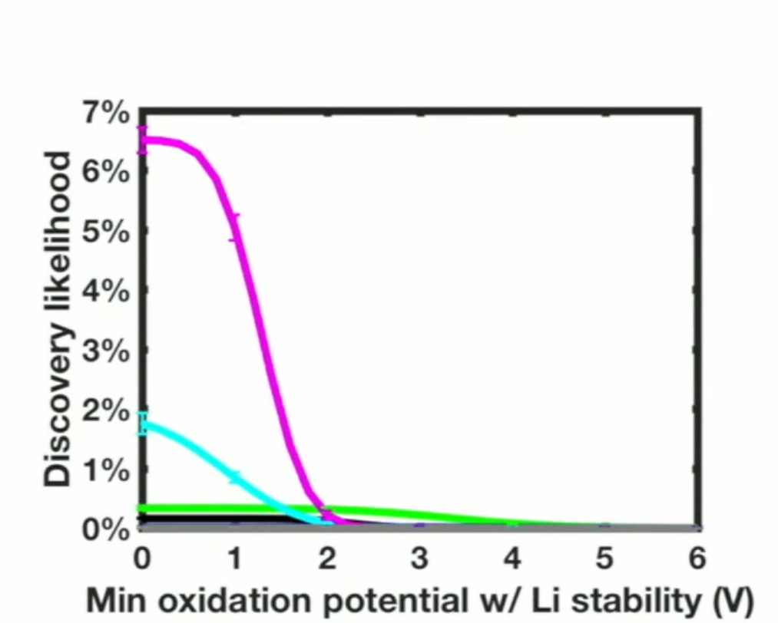
Likelihood of success
We are 100x more likely to find two superionic materials that are stable against reduction at 0V and oxidation at 4V, than one superionic “wonder” material with 4V oxidation stability and 0V reduction stability.
Phosphides
Nitrides
Chlorides
[6] Sendek, Austin D., Ekin D. Cubuk, Evan R. Antoniuk, Gowoon Cheon, Yi Cui, and Evan J. Reed. "Machine learning-assisted discovery of many new solid li-ion conducting materials." arXiv preprint arXiv:1808.02470 (2018).
25-11-2021

Slide 35
Why believe a model which works half the time?
It comes down to the way that we think about this as being the best we can do with the data that we have and the the urgency of the energy challenge that we're faced with, means we don't have a whole lot of time to to continue in doing trial and error.
It becomes really important for us to squeeze all predictive power out of the data that we can get and in the worst case scenario that the models are models trained on on this data don't have much predictive accuracy.
Then, we are reduced to going back to trial and error which is essentially what what we're doing anyway.
So we see this as the most informed way forward, could be wrong, but will only get better with time.
[6] Sendek, Austin D., Ekin D. Cubuk, Evan R. Antoniuk, Gowoon Cheon, Yi Cui, and Evan J. Reed. "Machine learning-assisted discovery of many new solid li-ion conducting materials." arXiv preprint arXiv:1808.02470 (2018).
25-11-2021

Slide 36
Conclusion
Model is 3x better than random guessing. [5]
Holistic screening of all known Li containing solids and discovery of several new superionic conducting structures is done.
Identification of many exciting new materials for further development was done.
These rapid models enable high-level insights, including new evidence that Li-metal batteries may need two electrolytes instead of one.
[5] Sendek, Austin D., Qian Yang, Ekin D. Cubuk, Karel-Alexander N. Duerloo, Yi Cui, and Evan J. Reed. "Holistic computational structure screening of more than 12000 candidates for solid lithium-ion conductor materials." Energy & Environmental Science 10, no. 1 (2017): 306-320.
25-11-2021

Slide 37
Data driven future/Future scope
Demand for clean energy will increase
Computing power will increase.
The amount of materials data will increase.
Full batteries will be designed more effectively and efficiently with machine learning. [5]
This approach is very general and will accelerate efforts in solar, electronics and more!
[5] Sendek, Austin D., Qian Yang, Ekin D. Cubuk, Karel-Alexander N. Duerloo, Yi Cui, and Evan J. Reed. "Holistic computational structure screening of more than 12000 candidates for solid lithium-ion conductor materials." Energy & Environmental Science 10, no. 1 (2017): 306-320.
25-11-2021

Slide 38
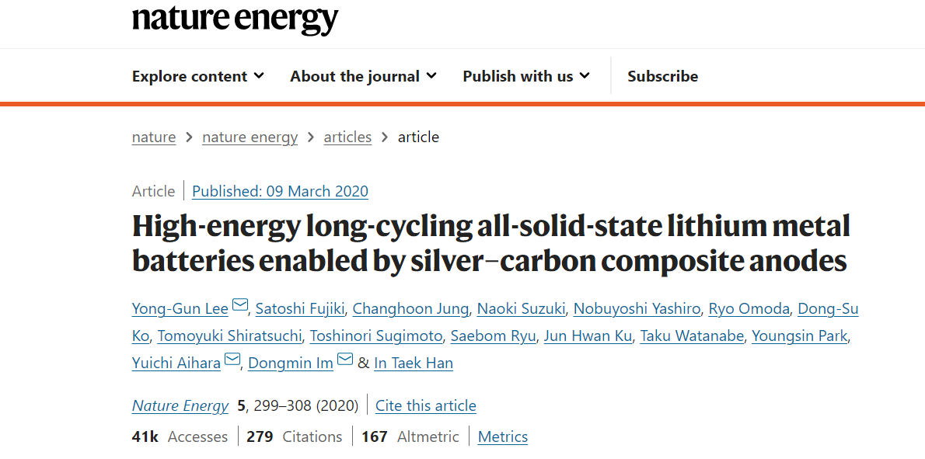
When can we expect solid state batteries?
[15] Lee, Yong-Gun, Satoshi Fujiki, Changhoon Jung, Naoki Suzuki, Nobuyoshi Yashiro, Ryo Omoda, Dong-Su Ko et al. "High-energy long-cycling all-solid-state lithium metal batteries enabled by silver–carbon composite anodes." Nature Energy 5, no. 4 (2020): 299-308.
25-11-2021

Slide 39
When can we expect solid state batteries?
Samsung, for example, has developed a solid-state battery prototype that solves the dendrite problem(happens when a Li metal Anode is used) by using silver-carbon (Ag-C) to form the anode, achieving a battery that’s only five micrometers thick.
This ultrathin Ag-C nanocomposite layer allowed the company to boost energy density up to 900 Wh/L.
For comparison, today’s best lithium-ion batteries have energy densities just below 700 Wh/L. The expansion of the company's prototype would enable an EV to travel up to 500 miles (800 km) on a single charge, with a life cycle of more than 1,000 charges. You're talking about a battery pack that would last for over 500,000 miles.
[15] Lee, Yong-Gun, Satoshi Fujiki, Changhoon Jung, Naoki Suzuki, Nobuyoshi Yashiro, Ryo Omoda, Dong-Su Ko et al. "High-energy long-cycling all-solid-state lithium metal batteries enabled by silver–carbon composite anodes." Nature Energy 5, no. 4 (2020): 299-308.
25-11-2021

Slide 40
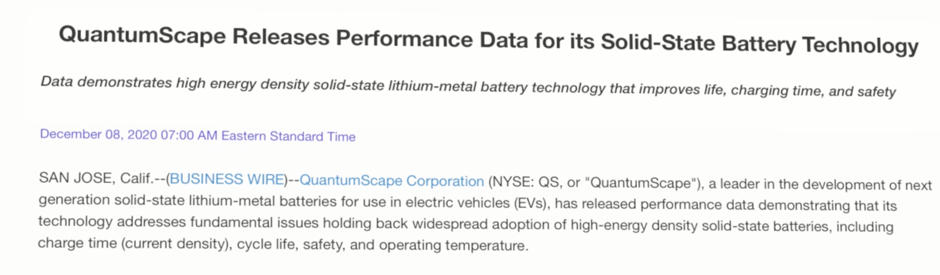
When can we expect solid state batteries?
[17] https://ir.quantumscape.com/news/news-details/2020/QuantumScape-Releases-Performance-Data-for-its-Solid-State-Battery-Technology/default.aspx
25-11-2021

Slide 41
When can we expect solid state batteries?
From the startup perspective, California-based QuantumScape, which is actually backed by Volkswagen, released a report in December 2020 showing that its solid-state cells can charge to 80% of capacity in 15 minutes, retain more than 80% of its capacity after 800 charging cycles, and has a volumetric energy density of more than 1,000 Wh/L.
In its battery, nickel manganese cobalt oxide is used as the cathode and the anode is made of pure lithium metal, like I mentioned earlier.
As for timing, this isn't supposed to hit initial production until 2024.
Toyota is supposed to be unveiling their solid-state-based EV this year, but they've also stated that it won't be in mass production until 2025.
[17] https://ir.quantumscape.com/news/news-details/2020/QuantumScape-Releases-Performance-Data-for-its-Solid-State-Battery-Technology/default.aspx
25-11-2021

Slide 42
When can we expect solid state batteries?
The trend here is. 2024, 2025, and 2026. That's when they expect these batteries to start hitting production. Why is that? There are still several issues to iron out on this technology.
One of which is manufacturing. Most of these batteries require very different manufacturing techniques and machinery than tradition batteries. They require extremely dry conditions during production, and the raw lithium and material capacity needed isn't there yet.
One company is taking a manufacturing first approach to solid-state batteries, in order to reduce the cost of production.
[18] Ulvestad, Andrew. "A brief review of current lithium ion battery technology and potential solid state battery technologies." arXiv preprint arXiv:1803.04317 (2018).
25-11-2021

Slide 43
When can we expect solid state batteries?
The American company Solid Power has been all-in on solid-state batteries and large-scale production processes for the past several years.
In December 2020, they begun pilot production of a 22-layer, all-solid-state battery cell (ASSB) at its pilot line in Colorado.
Their batteries are manufactured in a way that's compatible with the industry-standard roll-to-roll manufacturing used in current lithium-ion production.
They've partnered with both BMW and Ford.
[18] Ulvestad, Andrew. "A brief review of current lithium ion battery technology and potential solid state battery technologies." arXiv preprint arXiv:1803.04317 (2018).
25-11-2021

Slide 44
References
https://www.citroen.in/
https://www.massnetcomms.org/software-to-simplify-solar-farm-design/
https://www.ga-asi.com/remotely-piloted-aircraft/mq-9a
https://www.apple.com/in/
Sendek, Austin D., Qian Yang, Ekin D. Cubuk, Karel-Alexander N. Duerloo, Yi Cui, and Evan J. Reed. "Holistic computational structure screening of more than 12000 candidates for solid lithium-ion conductor materials." Energy & Environmental Science 10, no. 1 (2017): 306-320.
Sendek, Austin D., Ekin D. Cubuk, Evan R. Antoniuk, Gowoon Cheon, Yi Cui, and Evan J. Reed. "Machine learning-assisted discovery of many new solid li-ion conducting materials." arXiv preprint arXiv:1808.02470 (2018).
Cubuk, Ekin D., Austin D. Sendek, and Evan J. Reed. "Screening billions of candidates for solid lithium-ion conductors: A transfer learning approach for small data." The Journal of chemical physics 150, no. 21 (2019): 214701.
25-11-2021

Slide 45
References
https://medium.com/data-science-group-iitr/logistic-regression-simplified-9b4efe801389
https://www.businessinsider.in/tech/news/the-chess-grandmaster-who-was-beaten-by-a-computer-predicts-that-ai-will-destroy-most-jobs/articleshow/74288210.cms
Jordan, Michael I., and Tom M. Mitchell. "Machine learning: Trends, perspectives, and prospects." Science 349, no. 6245 (2015): 255-260.
Ceder, G., and K. Persson. "The materials project: A materials genome approach." DOE Data Explorer, http://www. osti. gov/dataexplorer/biblio/1077798.[2016-08-28] (2010).
Huggins, Robert A. "Recent results on lithium ion conductors." In International Symposium on Solid Ionic and Ionic-Electronic Conductors, pp. 773-781. Pergamon, 1977.
Kamaya, Noriaki, Kenji Homma, Yuichiro Yamakawa, Masaaki Hirayama, Ryoji Kanno, Masao Yonemura, Takashi Kamiyama et al. "A lithium superionic conductor." Nature materials 10, no. 9 (2011): 682-686.
Wang, Shuo, Qiang Bai, Adelaide M. Nolan, Yunsheng Liu, Sheng Gong, Qiang Sun, and Yifei Mo. "Lithium Chlorides and Bromides as Promising Solid‐State Chemistries for Fast Ion Conductors with Good Electrochemical Stability." Angewandte Chemie International Edition 58, no. 24 (2019): 8039-8043.
25-11-2021

Slide 46
References
Lee, Yong-Gun, Satoshi Fujiki, Changhoon Jung, Naoki Suzuki, Nobuyoshi Yashiro, Ryo Omoda, Dong-Su Ko et al. "High-energy long-cycling all-solid-state lithium metal batteries enabled by silver–carbon composite anodes." Nature Energy 5, no. 4 (2020): 299-308.
https://nptel.ac.in/courses/106/106/106106139/
https://ir.quantumscape.com/news/news-details/2020/QuantumScape-Releases-Performance-Data-for-its-Solid-State-Battery-Technology/default.aspx
Ulvestad, Andrew. "A brief review of current lithium ion battery technology and potential solid state battery technologies." arXiv preprint arXiv:1803.04317 (2018).
https://medium.com/analytics-vidhya/confusion-matrix-accuracy-precision-recall-f1-score-ade299cf63cd
25-11-2021

Slide 47
Thank you.

